Slide 1
Interpreting Motion Graphs

Slide 2
Speed

Slide 3
Speed

Slide 4
Distance

Slide 5
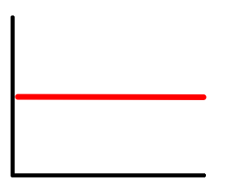
Speed

Slide 6
Distance

Slide 7
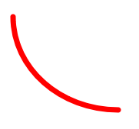
Speed

Slide 8
Distance

Slide 9
Distance

Slide 10
Distance

Slide 11
Speed

Slide 12
Distance

Slide 13
Speed

Slide 14
Speed

Slide 15
Distance

Slide 16
Distance

Slide 17
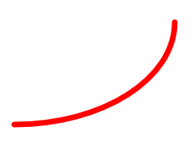
Speed

Slide 18
Speed

Slide 19
Distance

Slide 20
Speed

Slide 21
Distance

Slide 22
Speed

Slide 23
Distance

Slide 24
Distance

Slide 25
Speed

Slide 26
Distance

Slide 27
Distance

Slide 28
Distance

Slide 29
Speed

Slide 30
Distance

Slide 31
Distance

Slide 32
Distance

Slide 33
Speed

Slide 34
Speed

Slide 35
Speed

Slide 36
Speed

Slide 37
Speed

Slide 38
Speed

Slide 39
Speed

Slide 40
Distance

Slide 41
Speed

Slide 42
Speed

Slide 43
Distance

Slide 44
Distance

Slide 45
Distance

Slide 46
Distance

Slide 47
Distance

Slide 48
Speed

Slide 49
Speed

Slide 50
Speed

Slide 51
Speed

Slide 52
Distance

Slide 53
Speed

Slide 54
Speed

Slide 55
Distance

Slide 56
Distance

Slide 57
Speed

Slide 58
Distance

Slide 59
Distance

Slide 60
Distance

Slide 61
Time Formula

Slide 62
Speed Formula

Slide 63
Distance Formula

Slide 64
Speed Formula

Slide 65
Distance Formula

Slide 66
Time Formula

Slide 67
Speed Formula

Slide 68
Distance Formula

Slide 69
Time Formula

